Slide 1
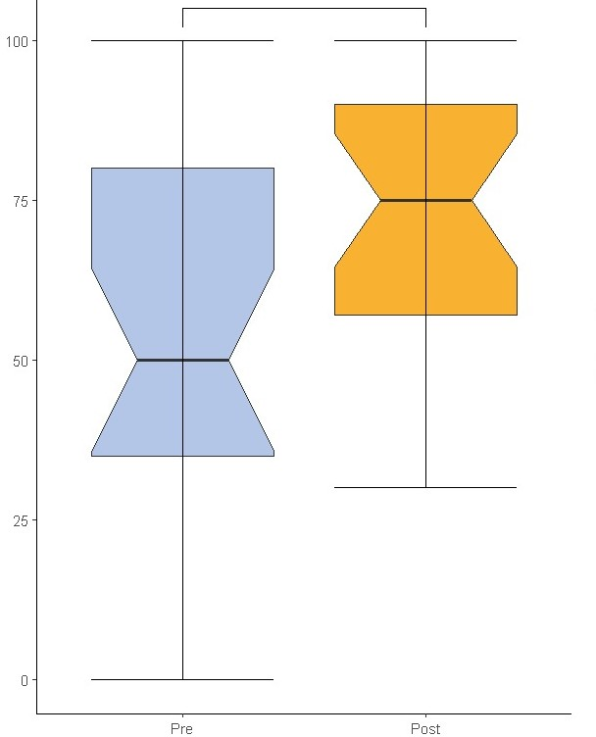
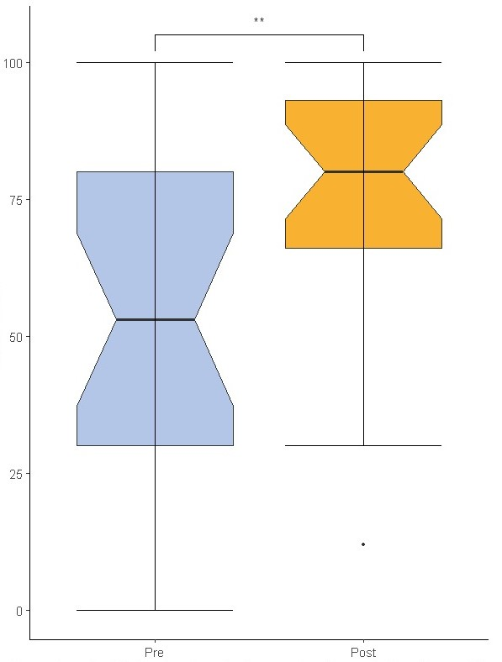
EMPOWERMENT TOWARDS MENTALLY HEALTHIER COMMUNITIES IN GHANA, KENYA, AND GERMANY: THE EFFECT OF AN ERASMUS PROGRAM DEDICATED TO GLOBAL MENTAL HEALTH Moritz Schepke^{1,2}, Simon Hass^{1,2}, Rick Peter Fritz Wolthusen^{2,3}
¹ Technical University Dresden, Faculty of Psychology, Dresden, Germany; ² On The Move e.V., Dresden, Germany; ³ Duke University Medical Center, Department of Psychiatry and Behavioral Sciences, Durham, NC, USA
Background
The Lancet Commission on Global Mental Health (2018) declared the treatment gap in mental health conditions unacceptably high worldwide, regardless of financial investments ¹
Traditional methods of teaching mental health (MH) may not reduce this gap
Need for (I) spaces of empowerment towards mentally healthier communities, (II) cross-cultural learning, and (III) inclusion of non-medical stakeholders
Results
All participants designed projects aimed to improve the MH-situation in their respective communities
Participants felt prepared to implement the projects (average rating: 7.5 out of 10)
Attitudes
participants developed more favorable attitudes (e.g., less stigma) towards MH conditions and individuals affected by them
Knowledge d = 0.642, d = 0.642, d = 0.650, 95 % CI [0.088; 95% CI [0.088; 1,197] 1.204]
p = .005 p = .003
p = .005 p = .003
Methods
German based NGO On The Move e.V. developed the Global Mental Health meets Social Innovation curriculum
Annual 8-week exchange program for students and staff members of Universities from Ghana, Kenya and Germany with different educational backgrounds
Topics: Global MH + Social Innovation
Product: design of a community-based MH-intervention
Evaluation of effects:
2 questionnaires before and after the program
conducted with one cohort in 2022 and one cohort in 2023 [N!!]
students
staff
members
Scale from 1-100: I know how to effectively advocate for people with mental health conditions.
Scale from 1-100: My knowledge about mental health conditions is sufficient to tackle mental health conditions in my communities.
In Advance | Weeks 1-3 | Weeks 4-6 | Weeks 7-8
Preparation of teaching modules | Community Mental Health & Social Innovation Curriculum | Development of Mental Health Allyship Program | Adaptation based on expert feedback
Home Country | Germany | Germany | Germany
Conclusions and Implications
Our curriculum provided knowledge about global MH and social innovation and offered cross cultural learning opportunities → Participants consider it more relevant to address MH issues on a community level and feel empowered to do so
Students with different educational backgrounds are capable of designing a community-based project to improve the MH-situation
A Curriculum as such may contribute to overcoming some of the traditional barriers in existing MH systems to reduce the MH treatment gap
In Advance |  | Afterwards
Community Mental Health & Social Innovation Curriculum | Development of Mental Health Allyship Program | Adaptation based on expert feedback
Home Country | Germany | Germany
¹ Patel, V., Saxena, S., Lund, C., Thornicroft, G., Baingana, F., Bolton, P., ... & Unützer, J. (2018). The Lancet Commission on global mental health and sustainable development. The Lancet, 392(10157), 1553-1598. https://doi.org/10.1016/S0140-6736(18)31612-X
© 2023 Schepke, M., Hass, S. Wolthusen, R. P. F. moritz.schepke@mailbox.tu-dresden.de

Slide 2
References
Patel, V., Saxena, S., Lund, C., Thornicroft, G., Baingana, F., Bolton, P., ... & Unützer, J. (2018). The Lancet Commission on global mental health and sustainable development. The Lancet, 392(10157), 1553-1598. https://doi.org/10.1016/S0140-6736(18)31612-X

